Slide 1


NASDAQ:FMFF
NYSE:FDGC
Follow us

Slide 2

The Company
Fudgecorp - parent company of Fudgeflix and Fudgemart
Fudgeflix is a recent addition, and stakeholders believe there is some customer overlap between the subsidiaries.
Fudgemart sells a variety of products and ships them to customers at no extra cost.
Fudgeflix offers streaming services and DVD rentals.
Fudgecorp executives believe the merger will grow the enterprise by offering a “one-stop shop” to customers.

Slide 3
Project Charter
Mission
Develop a data dashboard where stakeholders can assess performance metrics and KPIs across the enterprise and increase marketing effectiveness
Business Case
This project has the potential to provide short-term incremental benefits as well as revenue and marketing breakthroughs over the long run.
Stakeholders
Marketing, business analytics, finance/accounting, and executives
Project Team
Cartney Thompson
Jack Harris
Michael Morales

Slide 4
Business Processes
Stakeholders want to know the total revenue across both Fudgeflix and Fudegmart. This will allow the total revenue of Fudgecorp to be calculated, and will also enable stakeholders to compare and contrast each entity’s performance.
Stakeholders want to know where there is customer overlap between Fudgeflix and Fudgemart. This will give them more marketing information than they can currently obtain from the entities separately.
Stakeholders want to know sales information for Fudgemart. Currently, this information is only obtainable by querying multiple tables.
Stakeholders want to know Fudgeflix revenue by account. Currently, this information is only obtainable by querying multiple tables.
Notes:
More info means more knowledge of customer behavior and desire. Beer and diapers example – they don’t seem to be related, but there is a correlation in practice.

Slide 5
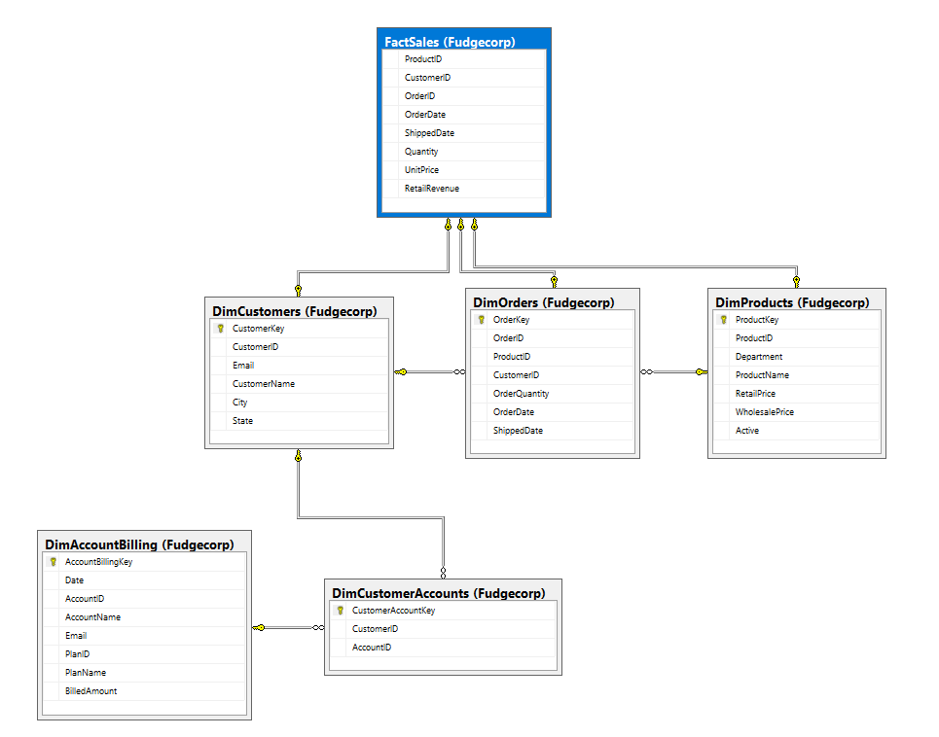
Star Schema

Slide 6
Performance Revenue Summary
FudgeMart
FudgeFlix
Notes:
99% of FudgeCorp’s Revenue from FudgeMart

Slide 7
Revenue By Month
FudgeMart
FudgeFlix
Notes:
More info means more knowledge of customer behavior and desire. Beer and diapers example – they don’t seem to be related, but there is a correlation in practice.

Slide 8
Performance FudgeMart - Category

Slide 9
Performance FudgeFlix - Category

Slide 10
Recommendations
Fudgecorp needs to find out why hardware and electronics sales have declined in Q4 of 2012. These categories make up the largest portion of sales.
Fudgecorp needs to determine the reason for the drop in premium rental accounts.
Fudgecorp needs to make better use of product/rental categorizations to gather more data about customer purchasing behavior.
Fudgecorp needs to leverage knowledge of purchasing behavior and customer overlap to make more precise marketing recommendations.

